Slide 1
Square Jigsaw Puzzle Solver Literature Review
Prepared by: Zayd Hammoudeh
(zayd.hammoudeh@sjsu.edu)

Slide 2
Problem Description
“Jigsaw Puzzle Problem”
Problem Statement: Reconstruct an image from a set of image patches.
Problem Complexity: NP-Complete when pairwise affinity of pieces is unreliable [1]
Problem Formulation: Set of square, non-overlapping patches
This type of puzzle is known as a “jig swap puzzle” [7]
Variation of the Problem: Allow/disallow patch rotation
A Key Difference with Standard Jigsaw Puzzle Solving: The source image you are trying to reconstruct is unknown.

Slide 3
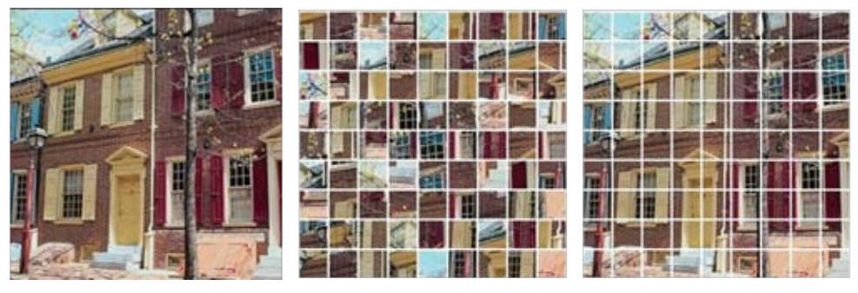
Square Jigsaw Puzzle Example
Source image (left) is divided into 81 (9x9) uniform, square patches (center). The goal is to organize the patches to reconstruct the source image (right).

Slide 4
Jigsaw Puzzle Solver Applicability
Possible and existing applications of the jigsaw puzzle problem include:
Computer Forensics: Reconstructing deleted JPEG, block-based images [2]
Document Investigation: Reconstruct shredded documents [3]
Bioinformatics: DNA/RNA modelling and reconstruction [4]
Archeology: Reconstruction of damaged relics [5]
Audio Processing: Voice descrambling [6]

Slide 5
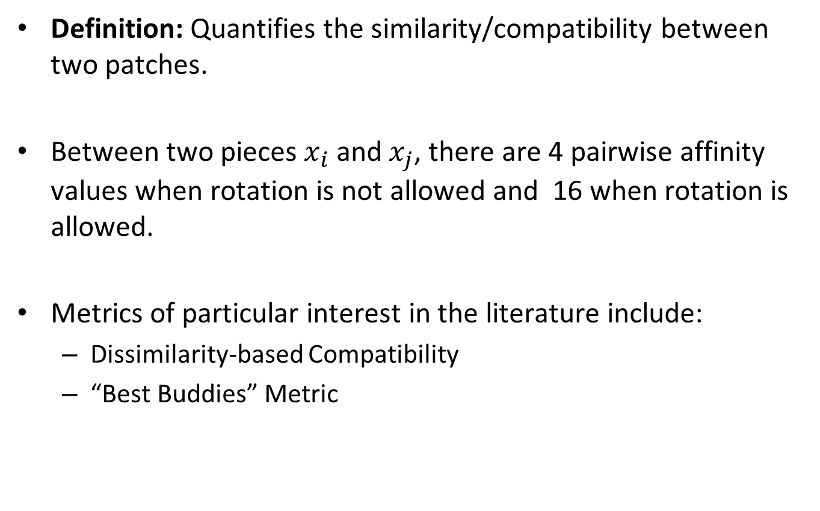
Pairwise Affinity
Definition: Quantifies the similarity/compatibility between two patches.
Between two pieces $x_{i}$ and $x_{j}$, there are 4 pairwise affinity values when rotation is not allowed and 16 when rotation is allowed.
Metrics of particular interest in the literature include:
Dissimilarity-based Compatibility
“Best Buddies” Metric

Slide 6
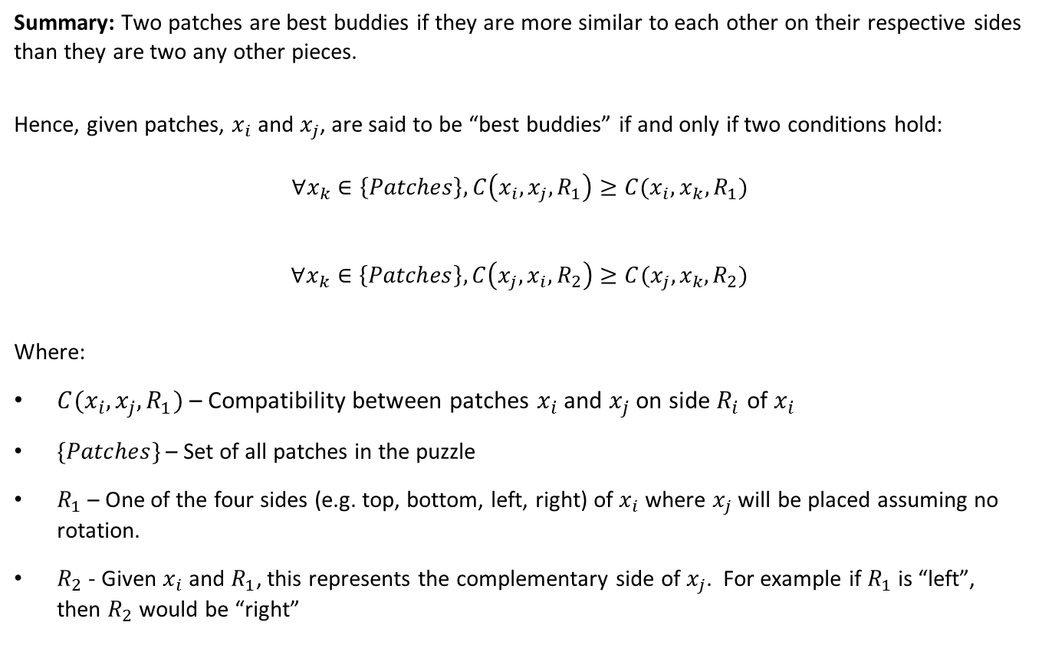
“Best Buddies” Metric
Summary: Two patches are best buddies if they are more similar to each other on their respective sides than they are two any other pieces.
Hence, given patches, $x_{i}$ and $x_{j}$, are said to be “best buddies” if and only if two conditions hold:
$$∀x_{k}∈\left\{Patches\right\}, C\left(x_{i},x_{j},R_{1}\right)≥C(x_{i},x_{k},R_{1})$$
$$∀x_{k}∈\left\{Patches\right\}, C\left(x_{j},x_{i},R_{2}\right)≥C(x_{j},x_{k},R_{2})$$
Where:
$C(x_{i},x_{j},R_{1})$ – Compatibility between patches $x_{i}$ and $x_{j}$ on side $R_{i}$ of $x_{i}$
$\{Patches\}$ – Set of all patches in the puzzle
$R_{1}$ – One of the four sides (e.g. top, bottom, left, right) of $x_{i}$ where $x_{j}$ will be placed assuming no rotation.
$R_{2}$ - Given $x_{i}$ and $R_{1}$, this represents the complementary side of $x_{j}$. For example if $R_{1}$ is “left”, then $R_{2}$ would be “right”

Slide 7
Existing Square Jigsaw Puzzle Approaches
Low Resolution “Solution Image” [8]
“Dense and Noisy” [7]
“Sparse and Accurate” [7]
Greedy Algorithm [10]
Genetic Algorithm [9]

Slide 8
Dense and Noisy
Proposed by Cho et. al. in [7]
Overview: In Cho et. al.’s work in [8], they assumed access to a correct, low resolution version of the original image.
In many real world applications, such a low resolution image is not available.
Solution: Estimate a low resolution image from a “bag of patches.”

Slide 9
List of References
[1] | Erik D. Demaine and Martin L. Demaine, “Jigsaw Puzzles, Edge Matching, and Polyomino Packing: Connections and Complexity”, Graphs and Combinatorics, volume 23 (Supplement), June 2007, pages 195–208.
[2] | Simson L. Garfinkel. 2010. Digital forensics research: The next 10 years. Digit. Investig. 7 (August 2010), S64-S73. DOI=http://dx.doi.org/10.1016/j.diin.2010.05.009
[3] | Liangjia Zhu, Zongtan Zhou, and Dewen Hu. 2008. Globally Consistent Reconstruction of Ripped-Up Documents. IEEE Trans. Pattern Anal. Mach. Intell. 30, 1 (January 2008), 1-13.
[4] | Marande, W., andBurger, G. 2007. Mitochondrial DNA as a genomic jigsaw puzzle. Science 318:415.
[5] | Benedict J. Brown, Corey Toler-Franklin, Diego Nehab, Michael Burns, David Dobkin, Andreas Vlachopoulos, Christos Doumas, Szymon Rusinkiewicz, and Tim Weyrich. 2008. A system for high-volume acquisition and matching of fresco fragments: reassembling Theran wall paintings. In ACM SIGGRAPH 2008 papers (SIGGRAPH '08). ACM, New York, NY, USA, , Article 84 , 9 pages.

Slide 10
List of References (Continued)
[6] | Yu-Xiang Zhao, Mu-Chun Su, Zhong-Lie Chou, and Jonathan Lee. 2007. A puzzle solver and its application in speech descrambling. In Proceedings of the 2007 annual Conference on International Conference on Computer Engineering and Applications (CEA'07), 171-176.
[7] | Cho, Taeg Sang, Avidan, Shai and Freeman, William T. "A probabilistic image jigsaw puzzle solver." Proc. IEEE Conf. Computer Vision and Pattern Recognition, 2010.
[8] | Cho, Taeg Sang, Avidan, Shai and Freeman, William T. "The Patch Transform and Its Applications to Image Editing," Proc. IEEE Conf. Computer Vision and Pattern Recognition, 2008.
[9] | Sholomon, D.; David, O. E.; and Netanyahu, N. S. 2013. A genetic algorithm-based solver for very large jigsaw puzzles. In IEEE Conference on Computer Vision and Pattern Recognition, 1767–1774.
[10] | Pomeranz, D.; Shemesh, M. & Ben-Shahar, O. (2011), A fully automated greedy square jigsaw puzzle solver., in 'CVPR' , IEEE Computer Society, , pp. 9-16.

Slide 11
List of References (Continued)
[11]
[12]
[13]
[14]
[15]

Slide 12
Pairwise Affinity
Given two patches x_{i} and x_{j}, the pairwise affinity is a metric that measures the similarity between the two patches.
Range: (0, 1]
Importance: A higher pairwise affinity indicates an increased likelihood the two patches are close or adjacent to each other in the original (source) image.
The shape and image content of the patches are used in determining pairwise affinity.
By limiting the image to square patches, the pairwise affinity becomes less reliable.
Only when pairwise affinity is low does the jigsaw puzzle problem become NP-Complete.

Slide 13

Graphical Model of the Jigsaw Puzzle Problem
The Jigsaw Puzzle Problem can be modeled using a graph:
Node: Represents a patch location in the source image
Node Label: Patch Contents
Edges: Link neighboring patches
Jigsaw Puzzle Problem Reduction: Find the most likely patch configuration to cover the graph.

Slide 14
Background

Slide 15
Previous Research into the Graphical Model and New Extensions
Cho et al. solved the patch configuration problem in their previous patch transform work (2008), but this work assumed access to a low-resolution version of the original image.
In many jigsaw puzzle problem scenarios, this assumption is not valid.
This paper evaluates two methods to address this issue:
Dense-and-Noisy Local Evidence – Estimate a low resolution image from the set of patches.
Spare-and-Accurate Local Evidence – Fix a small number of anchor patches at their correct locations.

Slide 16
Conditional Probability Review
Given two random events, A and B, the probability of A given B is defined as:
Example: Two six sided dice are rolled. Given that the sum of the two dice is less than or equal to 5, what is the probability the first roll was 2?
If A and B are independent, then:
Notation: Let A be an event and X be a random variable taking on the value x_{n}. Then the probability of A given X is equal to x_{n} is written as:

Slide 17
Random Variables Review
What is a Random Variable?
A function X whose domain is the set S of all possible experimental outcomes.
What is Cumulative Distribution Function (CDF) of a Random Variable?
A function F_{X}(x) that is defined as:
where P{X ≤ x} is the probability that X is less than x.
The domain of this function is the based off the set S that defines the random variable X.
The range of the function is [0, 1] and is monotonically increasing.

Slide 18
Random Variables Review
What is a probability density function (PDF) f_{X}(x)?
The derivative of the cumulative density function.
Domain of a PDF: Set S (i.e. the domain of X)
Range of a PDF: ≥0
Types of PDFs
Continuous
Discrete
Why is it called a density function?
Given two possible values of X (x₁ and x₂ where x₁≤x₂), then:

Slide 19
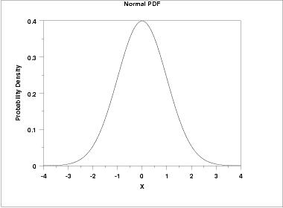
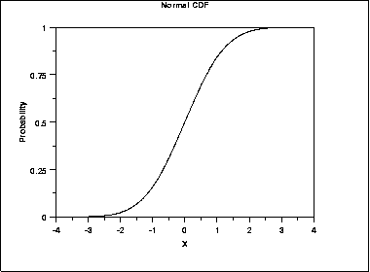
Example of a Continuous PDF and CDF Using the Normal Distribution
http://www.itl.nist.gov/div898/handbook/eda/section3/eda3661.htm

Slide 20
Random Variables Review
What is a joint probability distribution?
Given n random variables {X₁,X₂,…,X_{n}), it is a multivariate function f(X₁,X₂,…,X_{n}) that defines the joint probabilities of the random variables.
What are the properties of a joint probability distribution F_{XY}(x,y)? (The examples below show a bivariate distribution, but they apply the same for a multivariate function)
Property #1:
Property #2:
What is a marginal probability?
In a set of n random variables, it is the statistics of a subset of these random variables. For example, in a bivariate distribution F_{XY}(x,y), the marginal distribution (F_{X}(x))and densities (f_{X}(x)) for X are:

Slide 21
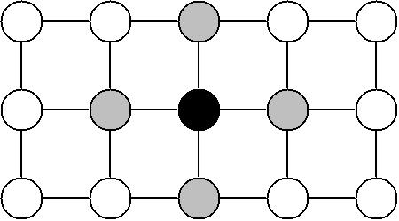
Markov Random Field (MRF)
A graphical model of a joint probability distribution. Given an undirected graph G=(𝒩, ε), then:
The 𝒩 vertices represent random variables.
The set of edges ε describes the inter-dependance between the vertices/random variables.
Below is a diagram of an example Markov Random Field:
For the center black vertex, then given its neighbors (i.e. the gray nodes), it is conditionally independent of all other nodes.

Slide 22
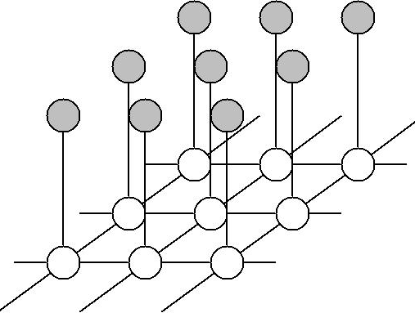
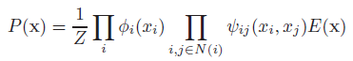
Markov Random Field in Computer Vision
In computer vision, pixels/patches are usually most dependent on other pixels/patches in their immediate vicinity and have very weak correlation with those further away.
This makes them well suited to be modeled using a MRF.
The diagram illustrates a structure for an MRF that could be used for image restoration.
The white nodes represent the unknown true pixel values, and the gray nodes represent the noisy pixel data.
Note that the noisy pixels are only connected to the true pixel data.
This models our belief that the estimated pixel values should depend on both the noisy data (grey nodes) and the estimated four neighboring pixel values.
homepages.inf.ed.ac.uk/rbf/CVonline/LOCAL_COPIES/AV0809/ORCHARD/

Slide 23
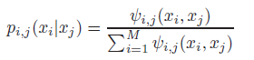
Markov Random Field (II)

Slide 24
Image Patch Transform
From Cho et al. (2008), the image patch transform synthesizes an image from a set of image patches. For a given source image, define y as a low resolution version of the original image and x as the reconstructed image.
Define P(x;y) as the probability of an assignment of, x, patches to the low resolution image y.
Term Definition:
Π – Product of sequences (similar to Σ but with multiplication)
Z – Normalization constant
i – Index of the a patch location
𝒩(i) – Markov blanket of node i
p(y_{i}|x_{i}) – Local evidence term used to steer image x to have a similar scene structure as y
p_{i,j}(x_{j}|x_{i}) – Probability of placing a path x_{j} in neighborhood of another patch x_{i}
p(x_{i}) – In most cases, this term is modeled as uniform distribution
E(x) – Exclusion term used to prevent patches being placed more than once.
The graphical model will maximize the probability of assignment P(x;y) using loopy belief propagation.

Slide 25
Belief Propagation
Belief propagation takes the form of a message-passing algorithm.
Simplest Modeling Approach: A Bayesian Network
Bayesian Networks are a Directed Acyclic Graph (DAG)
Example: Medical Diagnosis Problem – Construct a machine to infer which disease(s) is causing a patient’s symptoms.
Node Labels:
S: Individual smokes
L: Individual has lung cancer
B: Individual has bronchitis
D: Individual has shortness of breath (Dyspnoea)
X: X-Ray shows lung abnormality
Each node can be in a finite (e.g. binary) state.

Slide 26
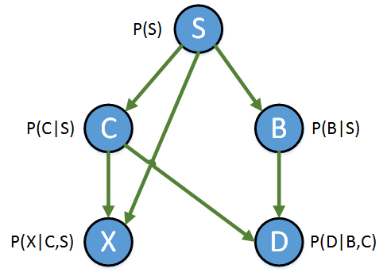
A Simple Bayesian Network
Value of Bayesian Network:
Diagnosis: P(Disease | Symptom)
Prediction: P(Symptom | Disease)
This is done by computing the marginal probabilities.
For large and/or complex Bayesian Networks, the relationships between nodes may be unclear forcing belief propagation between the nodes to determine relationships.

Slide 27
Belief Propagation
Two types of nodes in the graph:
Observed/Evidence Nodes: These are visible from the outside world.
Does a person smoke?
Does the X-Ray show an issue?
Hidden Variables:
Does the patient have bronchitis?
Does the patient have cancer?
Belief Propagation works based on peer-pressure (i.e. message passing). Each node listens to its neighbors.
Evidence enters the network at the observed notes and propagates through the network.
In a DAG (e.g. Bayesian Network), belief propagation yields exact marginal probabilities.

Slide 28
Loopy Belief Propagation (LBP)
DAGs by definition have no loops. However, what if the relationship between the nodes has a loop (e.g. a Markov Random Field)?
Answer: Loopy Belief Propagation.
Belief propagation in loopy graphs only lead to approximations of the true marginal probabilities.
Loopy Belief Propagation can sometimes converge to local minimum and not to the absolute minimum.
To improve the accuracy of loopy belief propagation, Cho et al. run the LBP algorithm three times with random seeds and then pick the best reconstruction out of the three attempts.

Slide 29
Patch Compatibility

Slide 30
Pairwise Patch Compatibility
There are four types of compatibilities for any pair of patches.
Patch x_{j} can be placed to the left/right/bottom/top of patch x_{i}.
Cho et al. propose five metrics to determine compatibility between patches irrespective of the compatibility orientation:
Dissimilarity-Based Compatibility
Boosting-Based Compatibility
Set-Based Compatibility
Image Statistics-Based Compatibility
Combination of Dissimilarity-Based and Image Statistics-Based Compatibility

Slide 31
Dissimilarity-Based Compatibility
Let x_{i} and x_{j} be square patches of size K by K. Below is an equation to calculate the dissimilarity between a left/right configuration of x_{j} and x_{i}.
There are three color channels for each pixel depending on the color channel used (e.g. RGB, LAB, etc.)
The pairwise patch compatibility probability is proportional to the dissimilarity via:
where σ_{c} is set as the difference between the smallest and second smallest D(x_{j},x_{i}) among all x_{j}.

Slide 32
Evaluation of the Compatibility Metrics
For all five metrics, patch pairs that are adjacent in the source image should have the highest compatibility score.
Procedure to compare the effectiveness of the five compatibility metrics:
For each patch, x_{i}, find the corresponding patch x_{j} with the highest compatibility.
Determine the percentage of cases where the patch’s highest compatibility pair was its true neighbor in the source image.
Repeat steps #1 and #2 above on 20 source images and average the resulting percentages from step #2 across the 20 images.

Slide 33
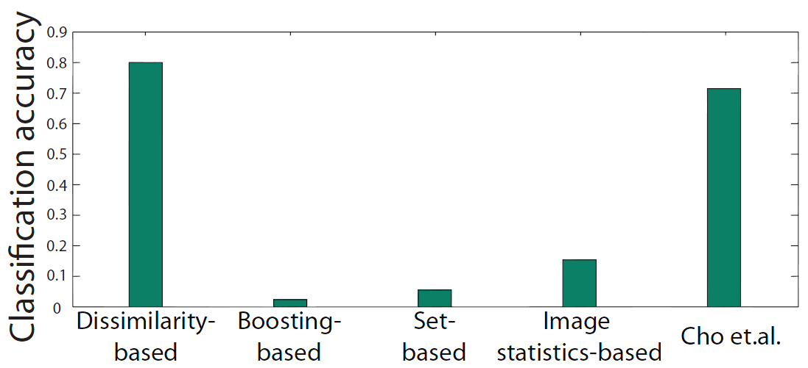
Evaluation of the Compatibility Metrics
Conclusion: Dissimilarity-based compatibility best identified neighboring patches.

Slide 34
Evaluation Notes
Although the dissimilarity-based compatibility is the most naïve approach, it performed the best since it focuses on the closest matching pair within the same image and not based off the patch boundaries from a set of training images.
The combination of dissimilarity-based and image statistics based compatibility in Cho et al. (2008) is useful for finding the most visually pleasing match not necessary the correct match.
Note: Regardless of the metric, compatibility performance is affected by the image content.
Images with more texture variation tend to have higher classification accuracy.

Slide 35
Local Evidence

Slide 36
Local Evidence
Local evidence determines the image layout and is needed by the loopy belief propagation algorithm.
It is what steers the reconstructed image x to the low resolution image y. Without it, the loopy belief propagation algorithm generates images the do not conforms to standard image layouts.
For low resolution image y and patch x_{i}, if x_{i} is fixed at location l, then the local evidence term p(y_{i}|x_{i}) is defined as:
where m(l) is the mean color of patch l, i is the i^{th} pixel in the low resolution image y as well as the i^{th} patch in the reconstructed image, and σ_{c}=0.4.
In the jigsaw puzzle problem, there is no low resolution image y. Two strategies to emulate the low resolution image are:
Dense-and-Noisy Local Evidence
Sparse-and-Accurate Local Evidence

Slide 37
Dense-and-Noisy Local Evidence
Summary: A set of patches in an image can be represented as a patch histogram. From there, an algorithm learns the correspondence between the patch histogram and a low resolution image.
To train their algorithm, Cho et al. used 15,000 source images with a total of 8,500,000 patches.
When clustering the patches, there are two primary patch representations used:
Color-Based (i.e. RGB)
Gradient-Based (i.e. Directional change in intensity or color of an image)

Slide 38
Patch Histogram – Defining the Histogram Bins
Standard histograms sort data into disjoint bins (i.e. sets)
Instead of using parametric values to define the bins, the Patch Histogram Algorithm defines bins based off clustering.
Using the 15,000 training images and a two step clustering process, N (e.g. 200) global cluster centers are found.
Clustering Algorithm: K-Means
When analyzing images other than the 15,000 training images, the images patches can then be placed into each of N bins/cluster centers to create a Patch Histogram.

Slide 39
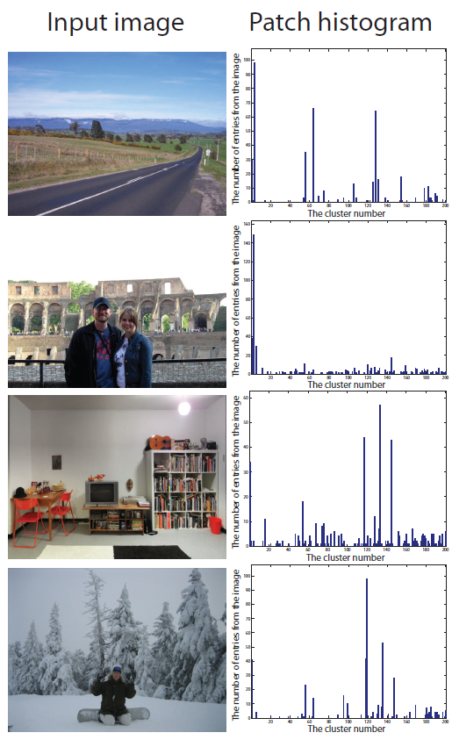
Patch Histogram Examples

Slide 40
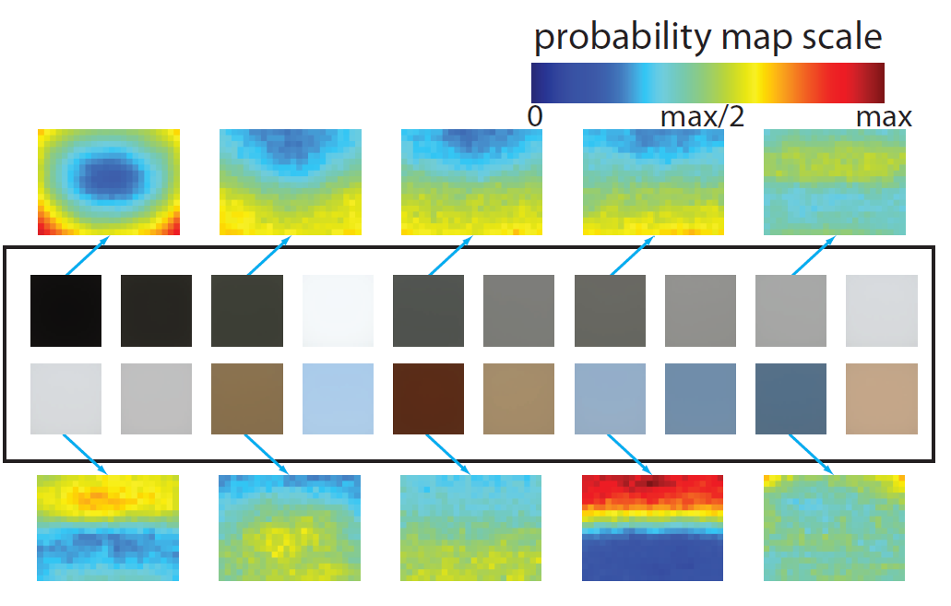
Properties of Patch Clusters
Individual patch clusters are more likely to occur at different parts of an image.
Example: Bright and blue clusters are more likely to occur near the top of an image due to the sky and lighting.
Above are the 20 most common color patch clusters along with the probability of those patches occurring throughout the image.

Slide 41
Low Resolution Image Estimation
Using the 15,000 training images, a linear regression function A is created.
Using the trained function A, any patch histogram h can be mapped to a corresponding low resolution image y.
Conclusion: An unsorted set of image patches contains spatial information about the source image.
Possible Explanation: In any image, there are potentially enough structural regularities that a set of patches capture basic geometric information.

Slide 42
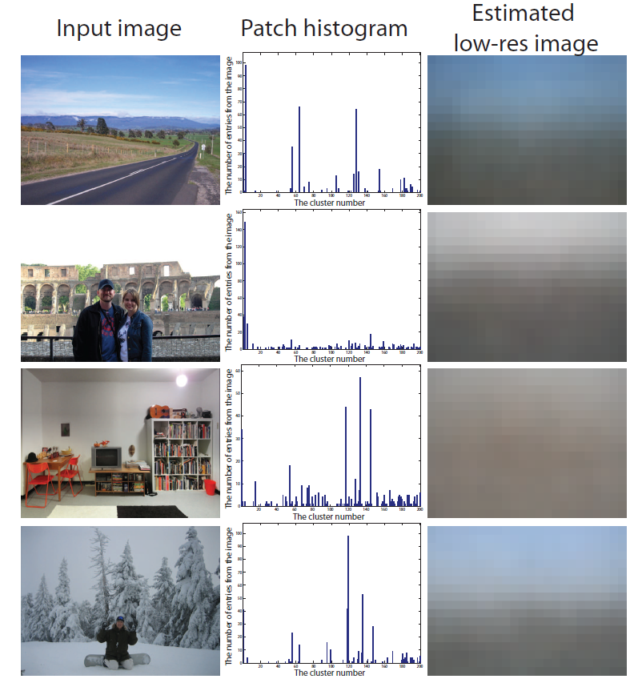
Low Resolution Image Estimation Examples

Slide 43
Sparse-and-Accurate Local Evidence
Most puzzle mapping algorithms solve the puzzle in two steps.
Frame (i.e. border) pieces are assembled first.
Interior is filled in second with a greedy algorithm
Spare-and-accurate is an extension of the general puzzle solving strategy fixing n patches at their correct position in the puzzle.
As more anchor patches are added, the puzzle solver accuracy increases.

Slide 44
Solving the Jigsaw Puzzle

Slide 45
Quantifying Puzzle Solving Performance
No consensus exists for quantifying the performance of a puzzle reconstruction algorithm. In this paper, the authors propose three metrics.
Direct Comparison – The percentage of patches in the reconstructed image that match their location in the ground-truth (i.e. source) image. Most naïve approach.
Cluster Comparison – The patches in the ground-truth and reconstructed images are mapped to their corresponding clusters in the patch histogram. The comparison algorithm determines the percentage of patch locations where the ground-truth and reconstructed image patches belong to the same cluster.
Neighbor Comparison – The percentage of neighbor patches (left/right/down/up) that are correctly assigned to the corresponding patch in the source image.
All three approaches have advantages and disadvantages. Hence, the true reconstructed image quality is a combination of all three metrics.

Slide 46
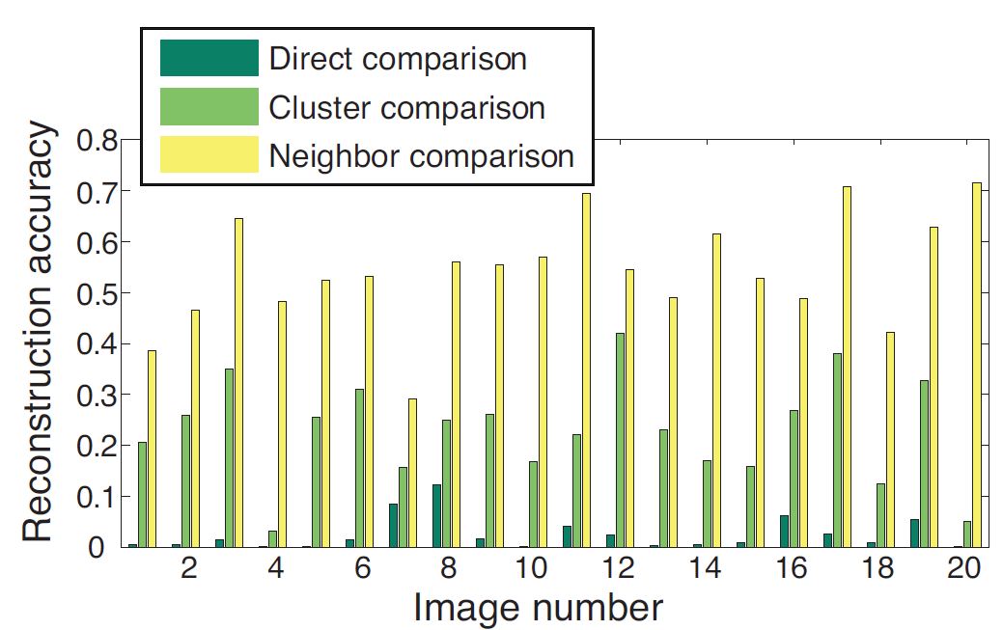
Reconstruction with Dense-and-Noisy Local Evidence
Puzzle solving using an estimated low resolution image provided results that still lead to distorted images.
For the 20 trial images, below is a comparison of the reconstruction accuracy using the three previously described metrics.
From the graph alone, it is not easy to visualize the quality of reconstruction.

Slide 47
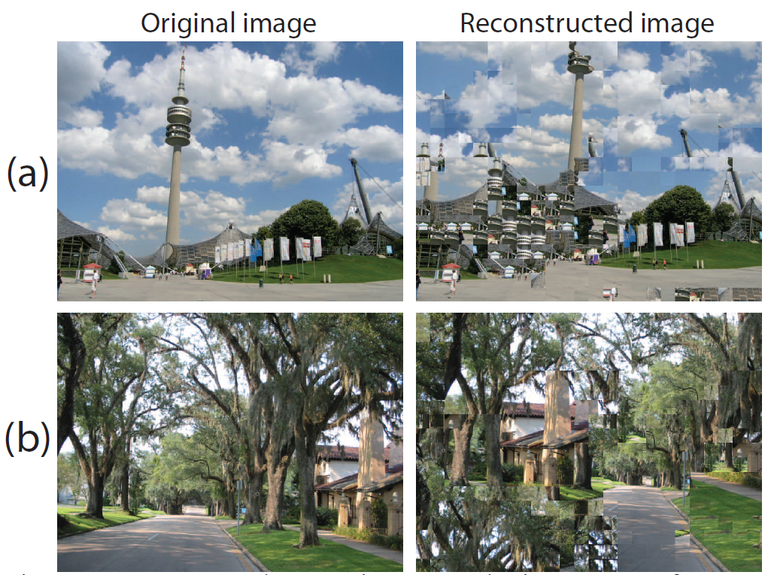
Reconstruction Using Dense-and-Noisy Local Evidence Examples
Significant lateral shifting occurred in both reconstructed images.

Slide 48
Reconstruction with Sparse-and-Accurate Local Evidence
Sparse-and-accurate places a set of k anchor patches at their correct location in the image and subsequently reconstructs the image around them.
Two factors affect this approach:
Number of Anchor Patches – The more anchor patches, the better the reconstruction.
Spacing of the Anchor Patches – The more evenly spaced the anchor patches, the better the reconstruction.
Question: If the patch locations are by definition unknown, how can they be fixed in their correct location?
Answer: Given N patches in the source image and the k predefined anchor points, the number of possible patch permutations is:

Slide 49
Combination of Noisy-and-Dense and Spare-and-Accurate Image Construction
The third option is to combine the noisy-and-dense and sparse-and-accurate approaches to see if their combination leads to superior results than the two approaches alone.
Comparison Baseline: Use a true low resolution version of the image and the Image Patch Transform described in Cho et al. (2008).

Slide 50
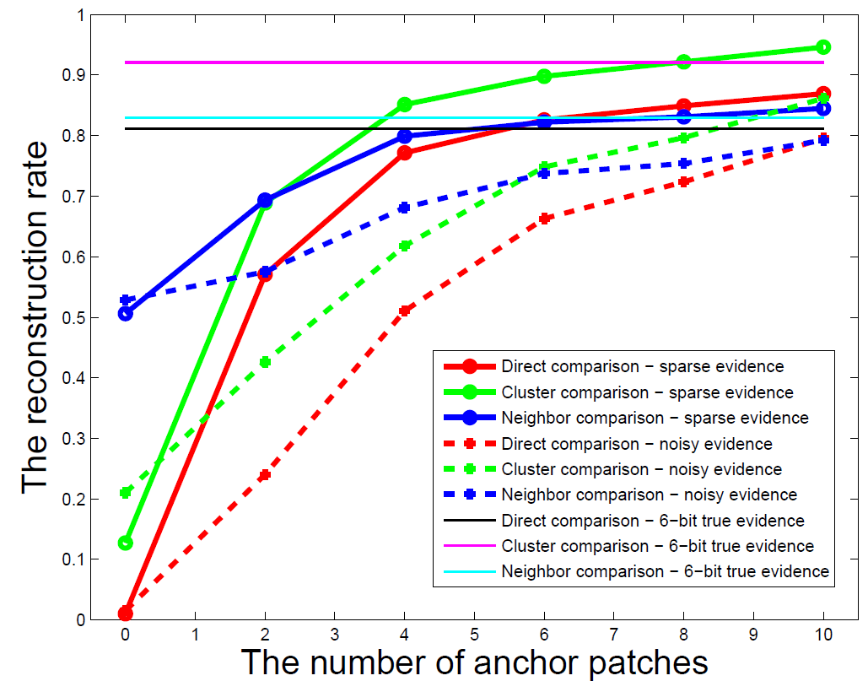
Comparison of Sparse-and-Accurate Techniques

Slide 51
Conclusions
Summary: For 6 or more anchor points, sparse-and-accurate local evidence provided similar or better results than the Image Patch Transform using a true low resolution image.
For a low number of anchor points, using an estimated low resolution image improved the results.
For larger numbers of anchor points, it is better to have no estimated low resolution image information.

Slide 52
References
Cho et al. “A probabilistic Image Jigsaw Puzzle Solver.” (2010)
Cho et al. “The Patch Transform and Its Application to Image Editing.” (2008)
Cottrell, Gary. “Lecture: Introduction to Loopy Belief Propagation” University of California, San Diego. Link: http://cseweb.ucsd.edu/classes/sp06/cse151/lectures/belief-propagation.pdf
Mondal et al. “Robust Solvers for Square Jigsaw Puzzles.” (2013).
Papoulis, A. & Pillai, S. Unnikrishna. “Probability, Random Variables, and Stochastic Processes.” Fourth Edition. 2001.
Rish, Irina. “A Tutorial on Inference and Learning in Bayesian Networks”.
Yedidia et al. “Understanding Belief Propagation and its Generalizations.” (2001).

